Slide 1
ChatGPT for coding
Enjoy the new era!
Jan Jarco, Lambda Data Science Society - 08.02.2023

Slide 2
„AI won’t take our jobs, people who use it will take our jobs!”
~Piotr Jarco

Slide 3
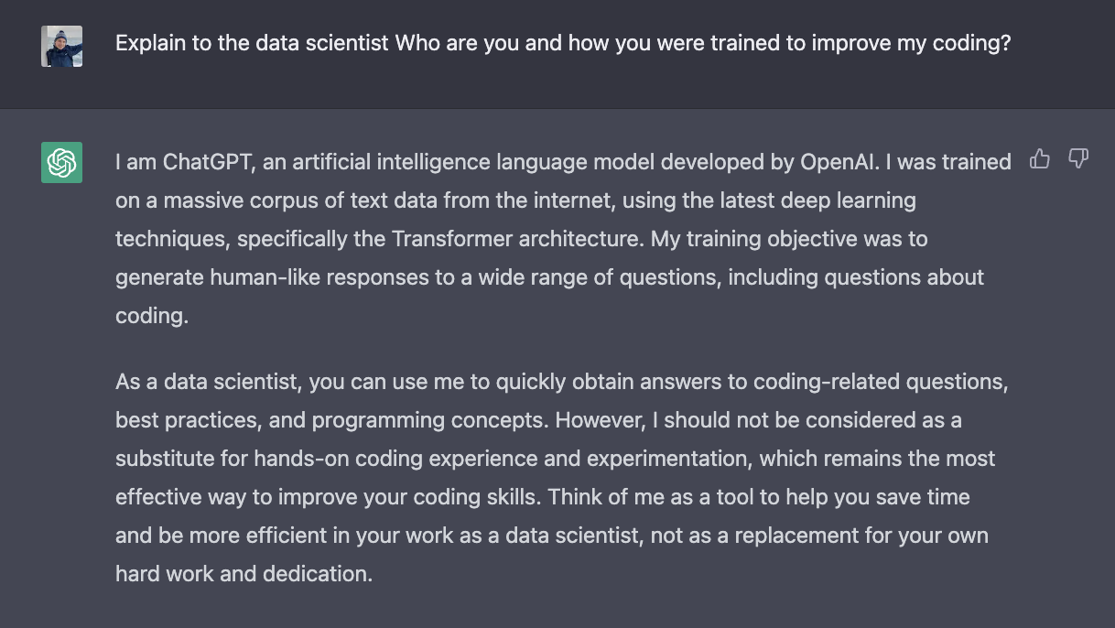
Let him speak for himself ;-)

Slide 4
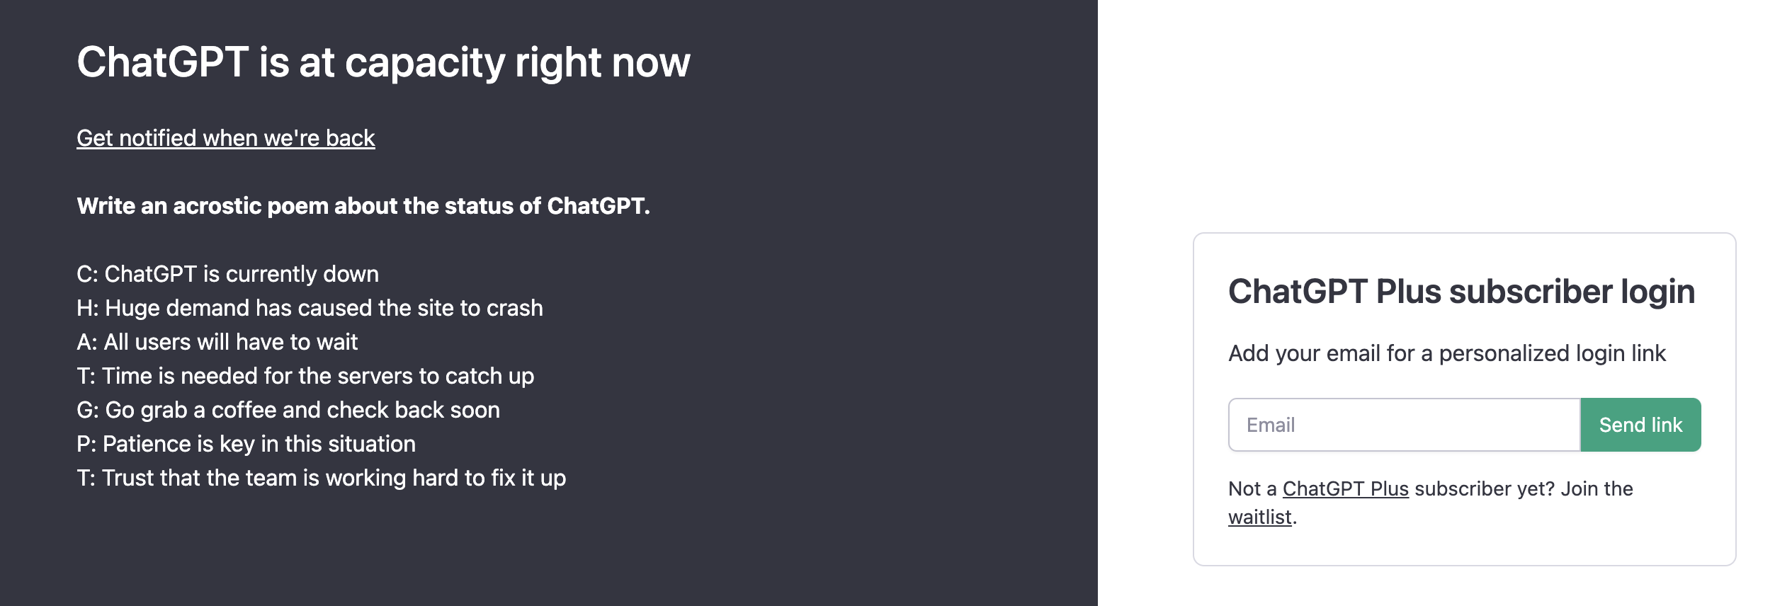
Signing up
It’s super easy but you have to be at the right time
Sign up at: https://chat.openai.com/auth/login

Slide 5
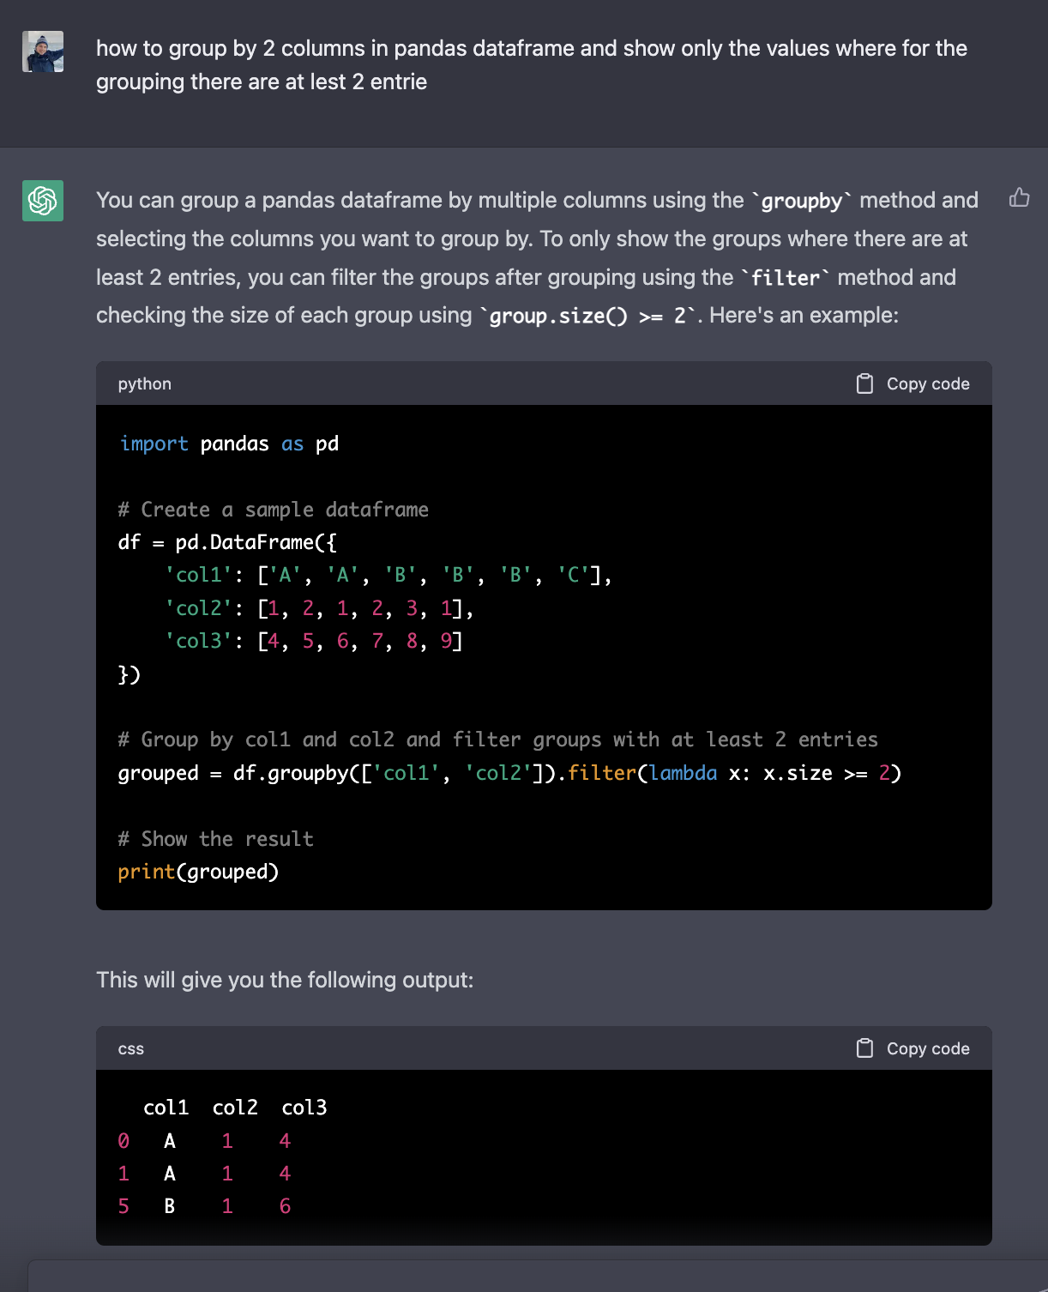
Ask how to do something
Just use your natural language as you would talk to your smarter, okay much smarter friend
Ask for a relevant method to the problem
Ask for different methods, styles of visualization
Relevant methods for problem in machine learning
Source: https://medium.com/geekculture/using-chatgpt-for-data-science-ac5f8a00fb5a

Slide 6
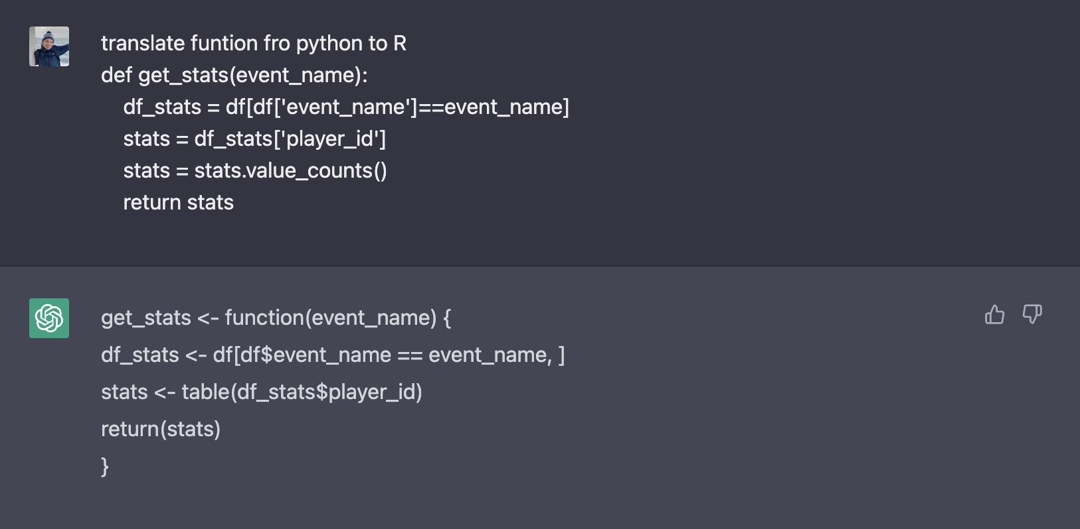
And many more…
Translate code between languages
Reformat the code, eg. to python PEP8
Explain the given code
Comment to improve readability of the code
Ask how to learn to code!
Source: https://medium.com/geekculture/using-chatgpt-for-data-science-ac5f8a00fb5a

Slide 7
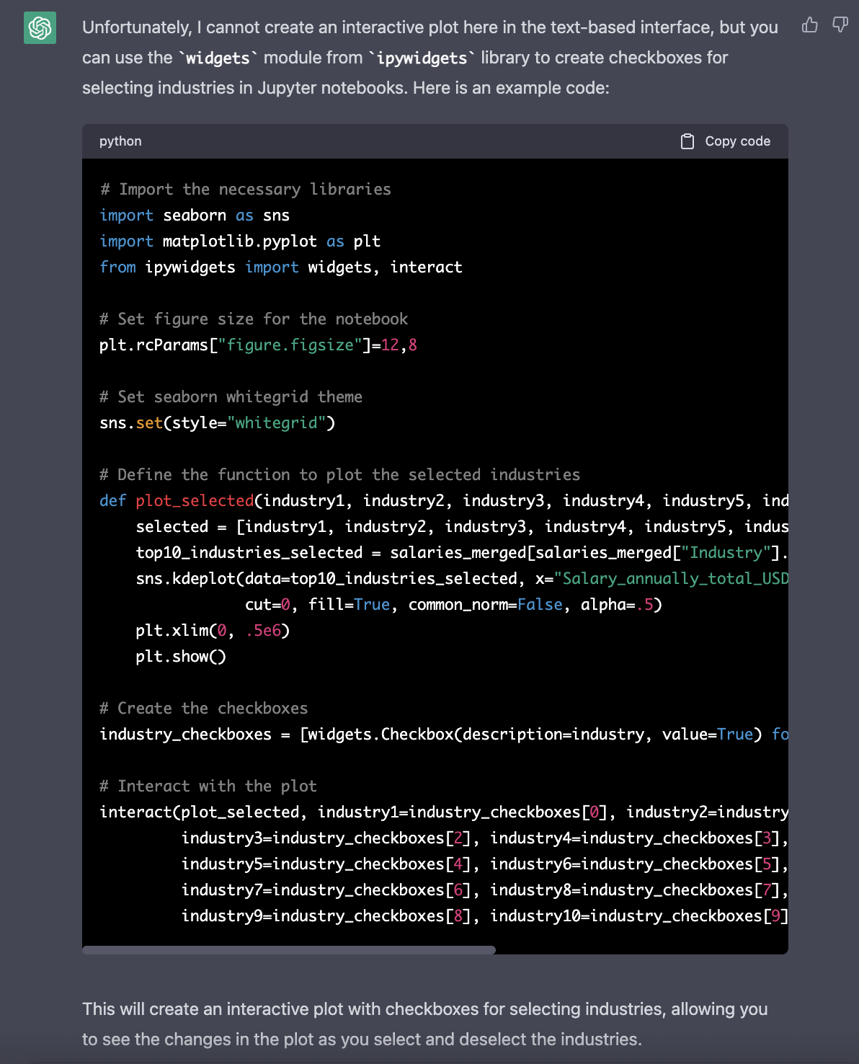
Limitations?
Trained with data up until 2021, so updated info may be lacking
The model can hallucinate, like other models presented so far, when ChatGPT does not know the answer it still tries to answer (e.g. by providing wrong or nonsensical information)
You always have to test that with your own knowledge
Source: https://medium.com/geekculture/using-chatgpt-for-data-science-ac5f8a00fb5a

Slide 8
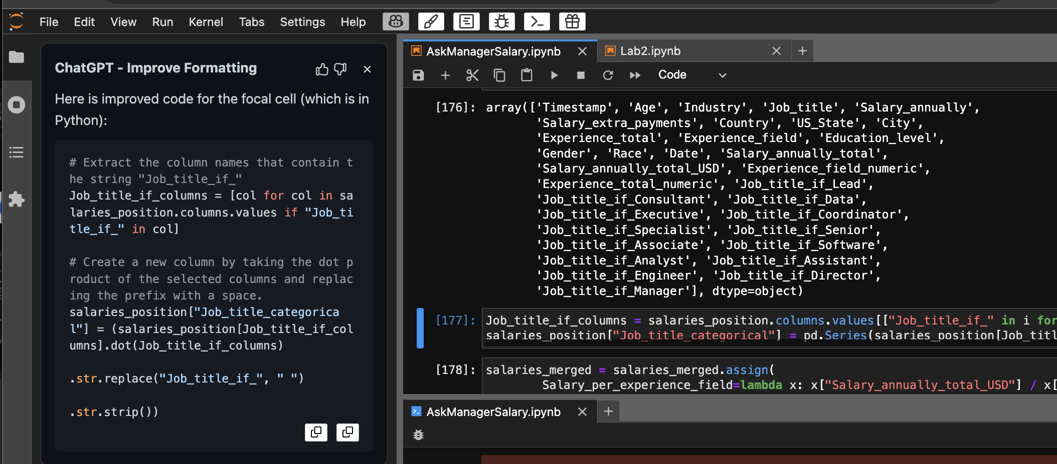
ChatGPT plug-in to Jupyter Lab
TiesdeKok’s GitHub
ChatGPT functionalities
Documentation and instructions for installation: https://github.com/TiesdeKok/chat-gpt-jupyter-extension
Format
Explain
Debug
Complete

Slide 9
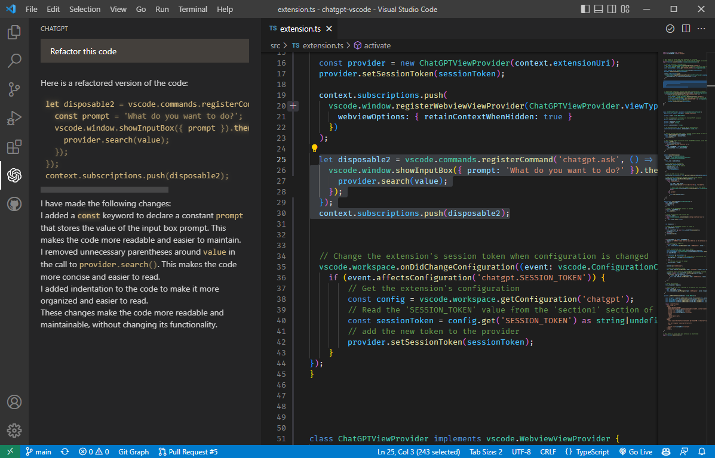
ChatGPT plug-in to VS Code
Yet nod discovered... at least by me
Extension: mpociot/chatgpt-vscode: A VSCode extension that allows you to use ChatGPT (github.com)

Slide 10
Thanks!
Enjoy the new era!
Jan Jarco, Lambda Data Science Society - 08.02.2023

